Slide 1
Merge Sort
Another extremely efficient approach to sorting

Slide 2
MergeSort
Break data down to single pieces, then recombine in order

Slide 3
What is MergeSort?
Like QuickSort, MergeSort is also:
Divide & conquer
Recursive
MergeSort repeatedly divides an array in half until it has broken the entire array into single elements
The “Divide” step – easy to do
Find the midpoint of the section
Call mergeSort to handle sorting the left half of this section
Call mergeSort to handle sorting the right half of this section
Elements are then combined back together in order
The “Conquer” / Merge / Combination step – more work required
Call merge to combine the two halves of this section

Slide 4
MergeSort in Pseudocode: The Dividing Step
mergeSort (data[], leftPosition, rightPosition){
// If there’s more than one element in this section
if(leftPosition < rightPosition)
// Calculate the midpoint (so we can divide in half)
middlePosition = leftPosition + rightPosition / 2
// sort the left half of this section (from start to middle)
mergeSort(data, leftPosition, middlePosition)
// Sort the right half of this section (from AFTER middle to end)
mergeSort(data, middlePosition+1, rightPosition)
// Combine the left and right halves of this section in sorted order
merge(data, leftPosition, middlePosition, rightPosition)
}

Slide 5
MergeSort in Pseudocode: The Combining/Merging Step – Set Up
merge(data[], leftPosition, midPosition, rightPosition){
// Calculate size of each half of section
// Add one to include middle element (remember these are position values)
leftLength = (midPosition – leftPosition) + 1)
// Don’t add one for right length as we don’t want to include the midPosition element here as well
rightLength = (rightPosition – midPosition)
// Create temp arrays, one for each side of the section
leftArray = new array[leftLength]
rightArray = new Array[rightLength]
// Fill temp arrays with the data from their side of the section
for(i = 0, i < leftArray length, i++)
leftArray[i] = data[leftPosition + i]
for(i = 0, i < rightArray length, i++)
rightArray[i] = data[(midPosition + i)+1]
Add 1 on to make sure the middle element is not added to the right array

Slide 6
MergeSort in PseudoCode: Combining in Order
// Merge the temp arrays in order
// Track where we are in temp data
leftPos = 0
rightPos = 0
// Track where we are inserting into in main array
mergedArrayPos = leftPosition
// While still within bounds of BOTH temp arrays
while leftPos < leftLength && rightPos < rightLength
// if current left array value is <= right array value
if leftArray[leftPos] <= rightArray[rightPos]
// copy left array value to main array (data) and move on by 1
data[mergedArrayPos] = leftArray[leftPos]
leftPos++
// Otherwise, do same for right array
else
// copy right array value to main array & move on by 1
data[mergedArrayPos] = rightArray[rightPos]
rightPos++
// move on to next slot in main array
mergedArrayPos++
We know this part already!
Loop through the temp arrays in sync to check which has the smallest value at each point
Copy that element to the main array

Slide 7
MergeSort in PseudoCode: Final Tidy Up
// At this stage, one of the arrays is empty but we don’t know which
// If left still has data, add that to main array
while(leftPos < leftLength){
data[mergedArrayPos] = leftArray[leftPos]
leftPos++
mergedArrayPos++
// If right still has data, add that to main array
while(rightPos < rightLength)
data[mergedArrayPos] = rightArray[rightPos]
rightPos++
mergedArrayPos++
Only one of these sections will happen at any time, but we don’t know which one

Slide 8
MergeSort in Pictures: Dividing The Data
Left half of array is processed (divided off)
Left half of array subsection is processed
Right half of array subsection is processed At this stage, all of left half has been broken into single elements. Now we recombine them in order
81 | 23 | 31 | 55
1
81 | 23
31 | 55
2
3
81
23
31
55

Slide 9
MergeSort in Pictures: Merging The Data
Combine individual elements into single unit in order At this stage, all of left half has been sorted. Now we work on the right half
81 | 23 | 31 | 55
1
81 | 23
31 | 55
2
3
81
23
31
55
4
23 | 81

Slide 10
MergeSort in Pictures: Dividing The Data (again)
Right half of array is processed
Left half of array subsection is processed
Right half of array subsection is processed At this stage, all of right half has been broken into single elements. Now we do the combination step (again)
81 | 23 | 31 | 55
1
5
81 | 23
31 | 55
2
3
6
7
81
23
31
55
4
23 | 81

Slide 11
MergeSort in Pictures: Merging The Data (again)
Combine individual elements into single unit in order At this stage, all of right half has been sorted. Now we combine the left and right overall halves
81 | 23 | 31 | 55
1
5
81 | 23
31 | 55
2
3
6
7
81
23
31
55
4
8
23 | 81
31 | 55

Slide 12
MergeSort in Pictures: Merging The Data (The Final Merge)
Combine the left and right halves in order of value At this point, the entire array is now in sorted order
81 | 23 | 31 | 55
1
5
81 | 23
31 | 55
2
3
6
7
81
23
31
55
4
8
23 | 81
31 | 55
9
23 | 31 | 55 | 81

Slide 13
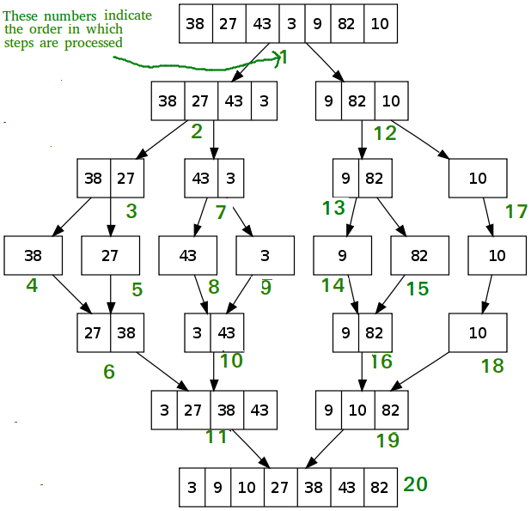
Another Example
Notes:
Diagram source: https://www.geeksforgeeks.org/merge-sort/

Slide 14
Big O Analysis
MergeSort has worst case of O(n log n)
Requires log n calls to break all data down to single elements
Requires n iterations to loop through the data when recombining
Unlike QuickSort, this is true performance
MergeSort always divides data in half
QuickSort division of data depends on how good the pivot value is for the data

Slide 15
MergeSort & Space Usage
Both QuickSort and MergeSort require O(log n) extra space for stack calls
Because they recursively divide the data, and that step is done log n times, they create log n method calls that need to be stored on the stack
QuickSort can actually take more, as it can split the data n times at its worst case
However, MergeSort also requires extra memory for every merge step
At most, we need n extra memory as we will need two extra arrays, each of size n/2
This is not the case for linked lists

